Slide 1
Password lock system
By:
Daniel Bashev
Georgi Vasilev
Niki Radoev

Slide 2

Why do I need a password lock system?

Slide 3
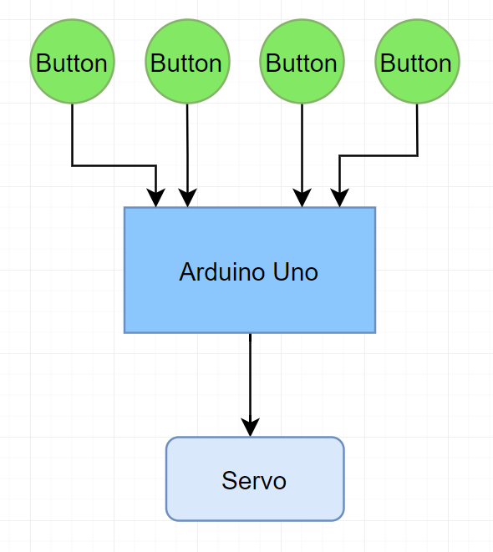

Main steps

Slide 4
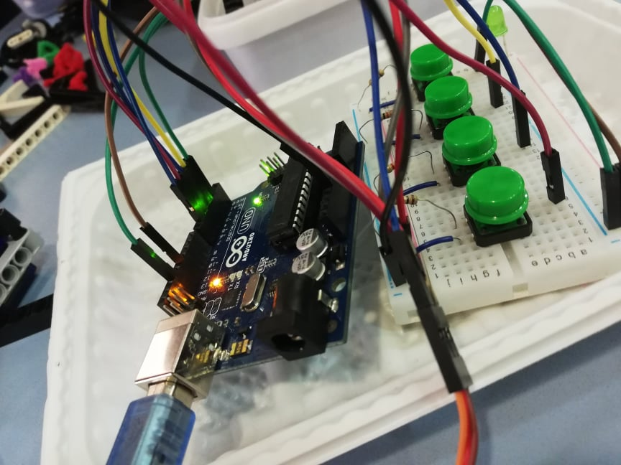
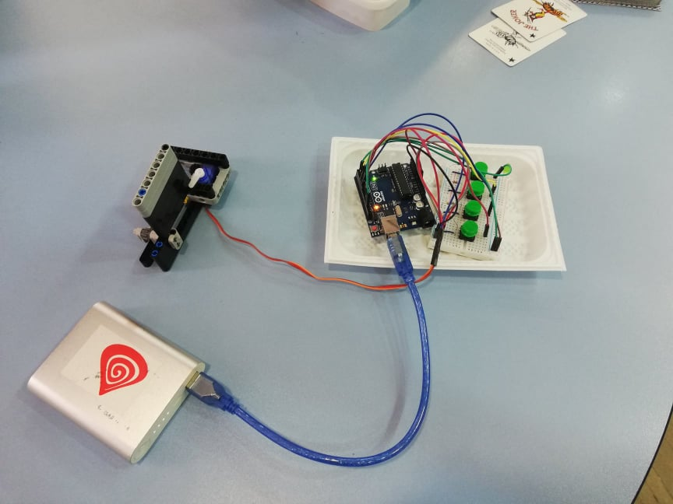
Working prototype

Slide 5
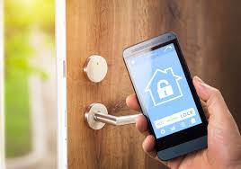
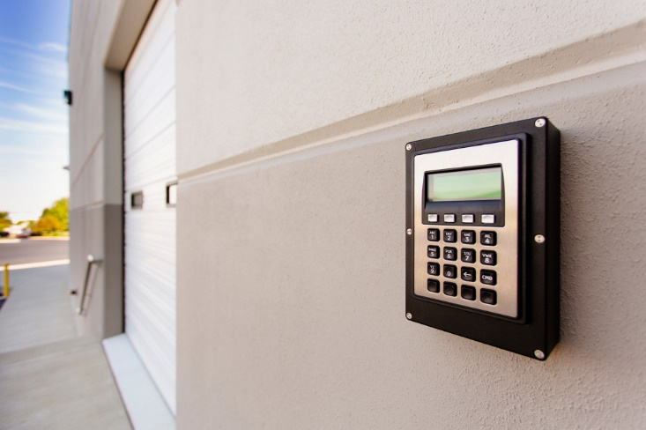
Possible future improvements

Slide 6

Thanks for your attention!

